Slide 1
Week 4 : Introduction to Machine Learning
Python for Machine Learning
Tuesday, June 27th

Slide 2
Machine Learning
Machine Learning
Supervised Learning
Unsupervised Learning
Clustering
Classification
Regression
Labelled
Unlabeled
Discrete
Continuous

Slide 3
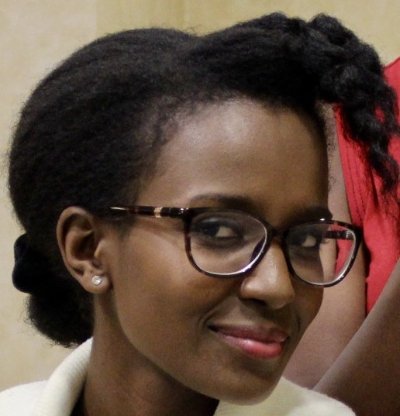
Supervised vs Unsupervised
Female Male
“This is a bunch of faces labelled as male or female. Based on a set of features learn to distinguish between them. Given a new face can you classify it correctly?”
Supervised Learning
Male Female
Input
“This is a bunch of faces. There are two groups of people in this dataset. Can you group/cluster them accordingly? Given a new face can you assign it to a cluster?
Unsupervised Learning
Input

Slide 4
Key Question?
Is your data labeled or not?

Slide 5
Classification vs Regression
Female Male
Discrete classes i.e. either an example is either male or female
Gender
Classification
Male Female
Input
4.999 6.2
Continuous values that can be decimal values e.g. height estimator
Height
Regression
Input
5.9 5.9

Slide 6
Types of Machine Learning
Supervised-
data comes with attributes that we want to predict
Classification
samples belong to two or more classes and we want to learn from already labeled data how to predict the class of unlabeled data. E.g. facial recognition of male and female faces.
Regression:
if the desired output consists of one or more continuous variables, then the task is called regression . E.g. predicting someone’s height.
Unsupervised Learning
The training data consists of a set of input vectors x without any corresponding target values
Clustering
Goal is to discover structure in data by identifying the set of similar groupings e.g.

Slide 7
Features
Choose Wisely!!!
Make sure your sample/examples are representative
Your model will inherit biases in your data!!

Slide 8
High Level Tasks
Train
Test/Evaluate
Apply

Slide 9



High Level Tasks
Train
Test/Evaluate
Apply

Slide 10
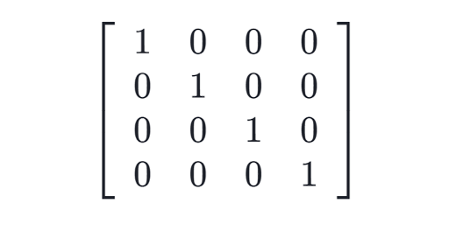

Train
Examples/Samples Needed
Each example/sample is represented by a set of features
In supervised learning, we have a set of target values(y)
Target Vector
Feature
One
Feature
Two
Feature
Three
Feature
Four
....
....
.....
....

Slide 11
Train
f(x)=y
x=input matrix of size n_samples by n_features
y=output vector of target values
f( )=
Notes:
What do the rows of the input matrix represent?
What do the columns of the input matrix represent?

Slide 12
Train
What do the rows of the input matrix represent?
What do the columns of the input matrix represent?

Slide 13

Train
Before starting the training remember to separate your data into training and test sets. Some algorithms require a development set which we will not look at for now.
Data
Training Set
Testing Set

Slide 14
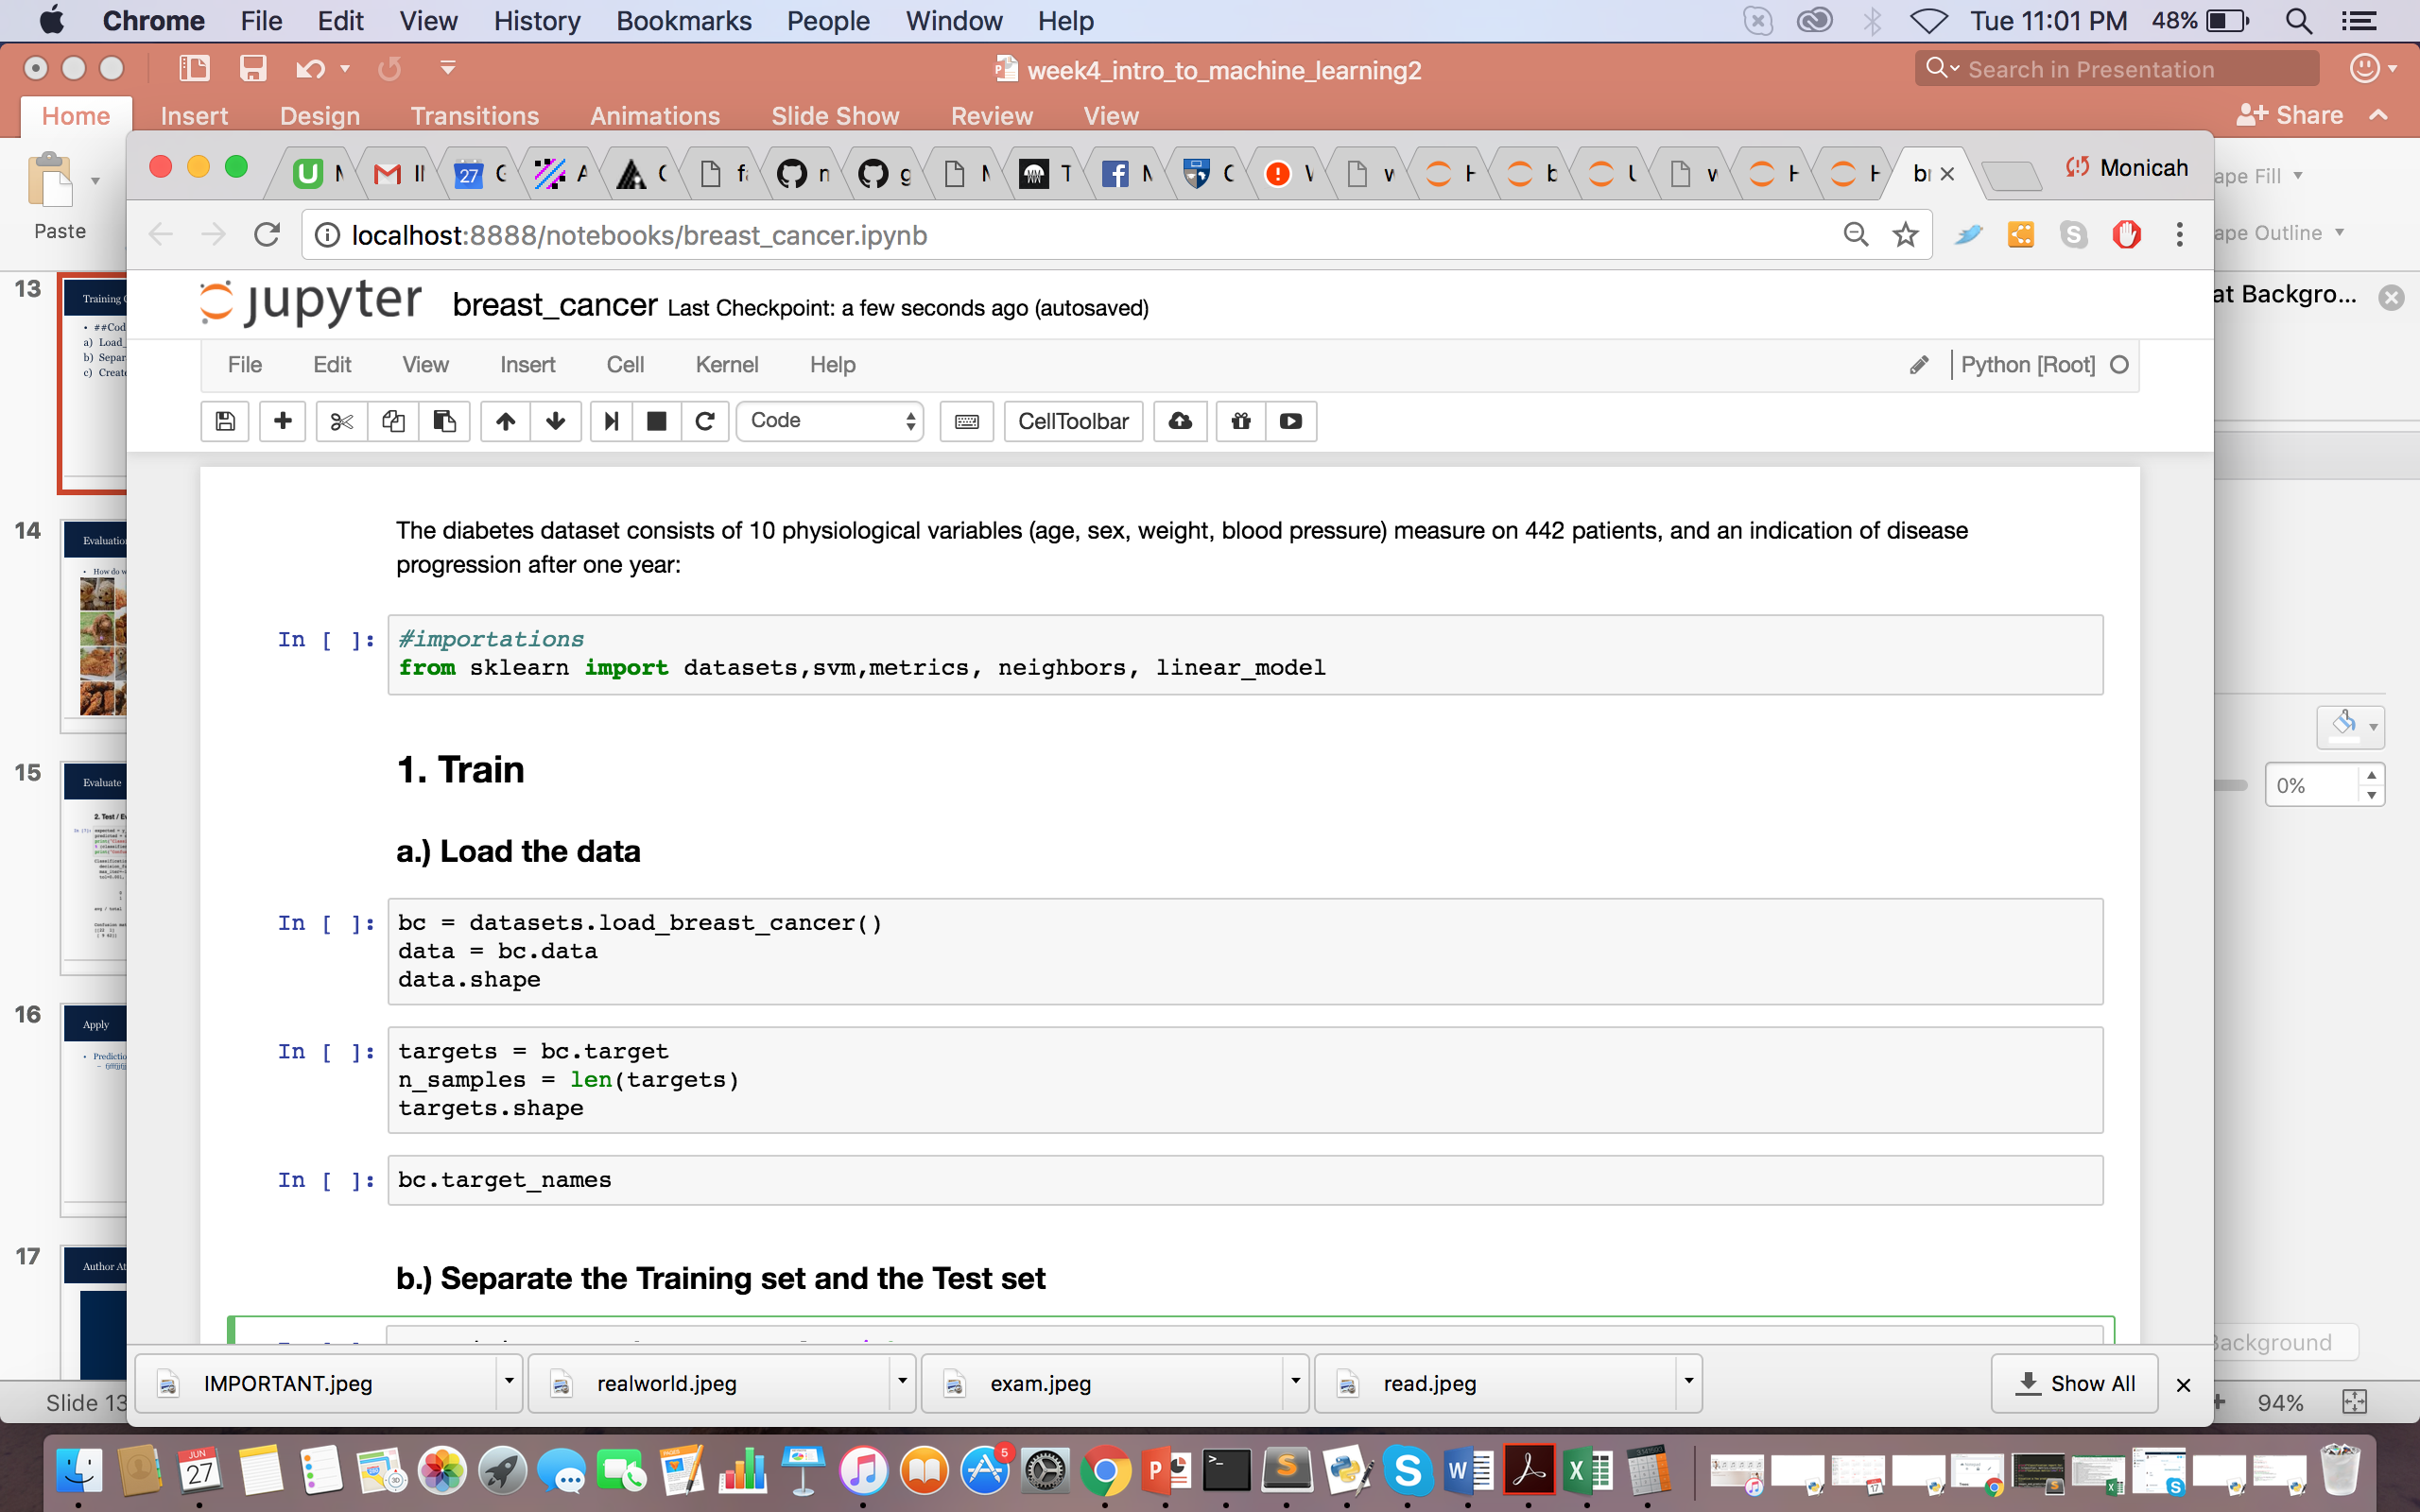
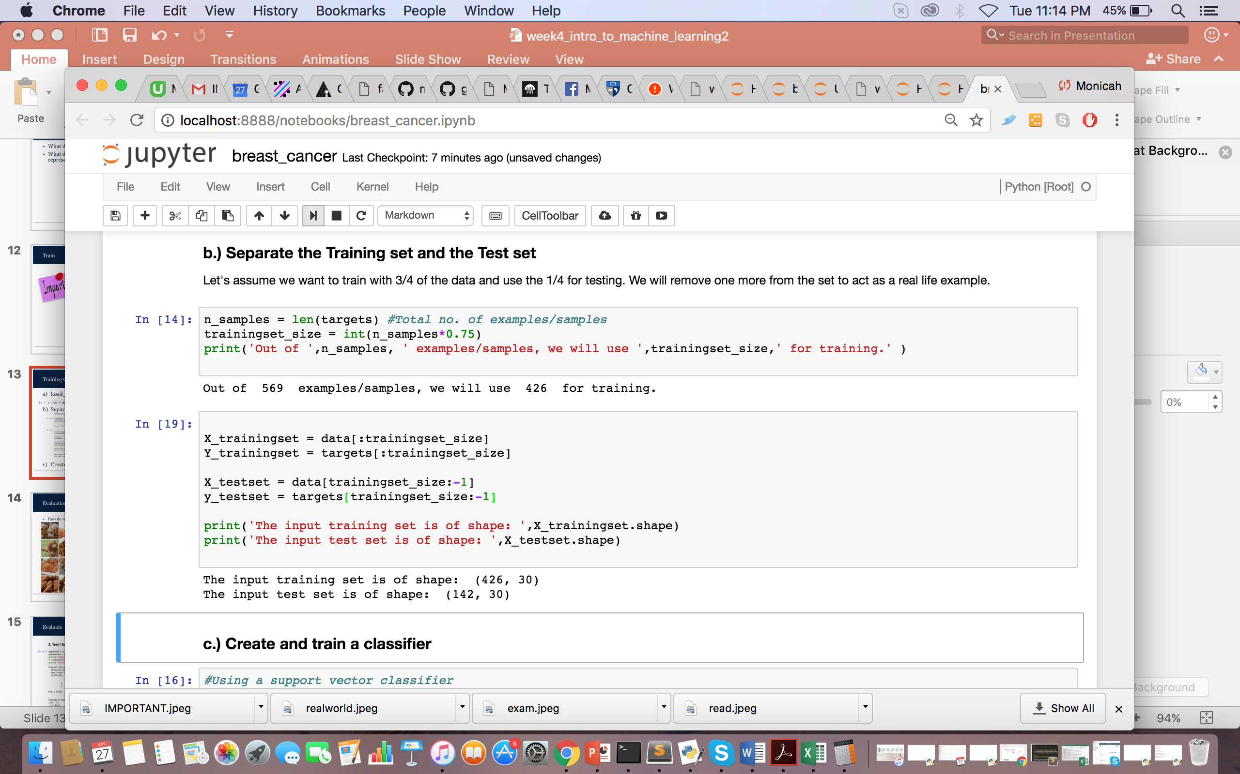
Training Code
Load_dataset()
Separate into training and test set

Slide 15
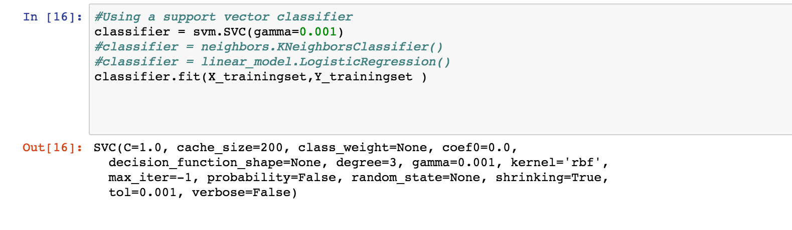
Training Code
Create and train a classifier

Slide 16
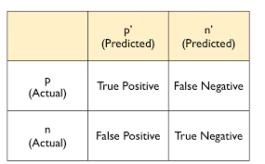
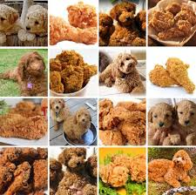
Evaluation
How do we evaluate accuracy?
Metrics
Accuracy
Precision
Recall

Slide 17
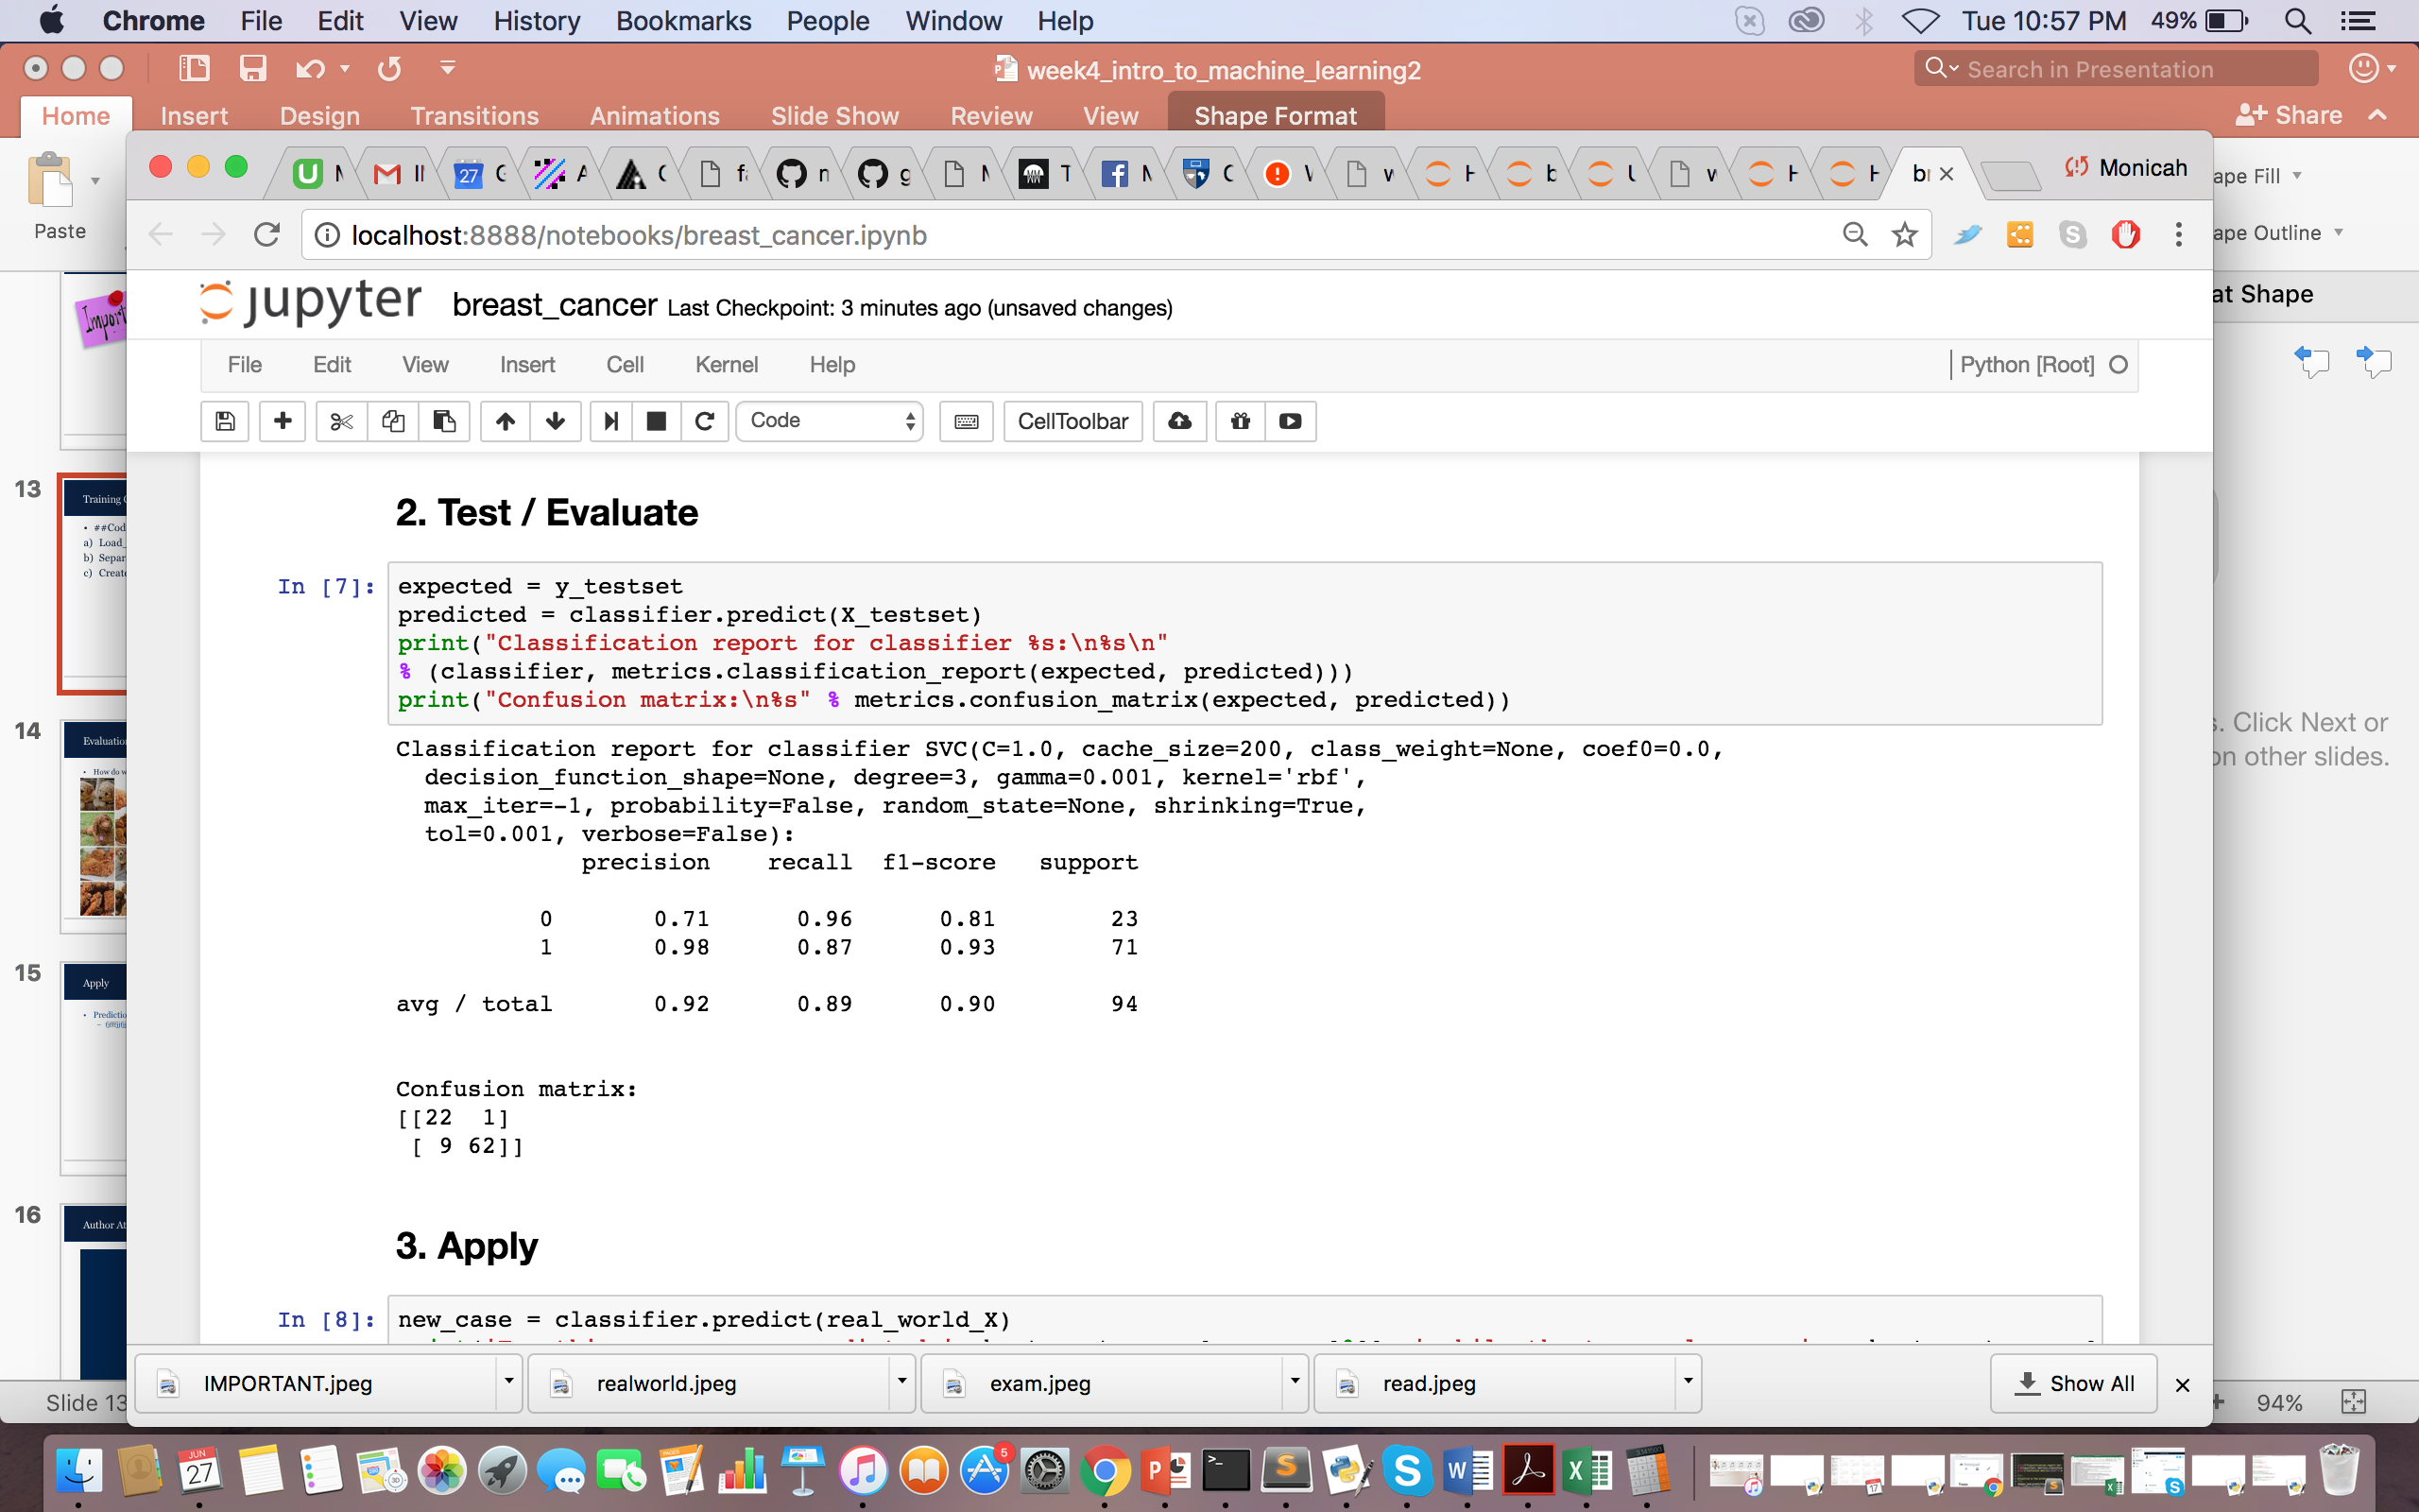
Evaluate

Slide 18
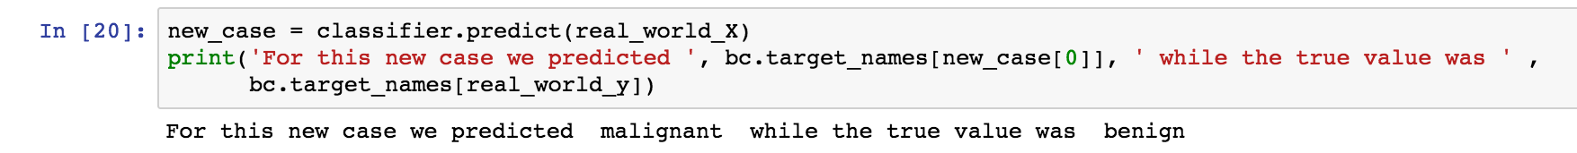
Apply
Prediction:

Slide 19
Author Attribution
Example

Slide 20
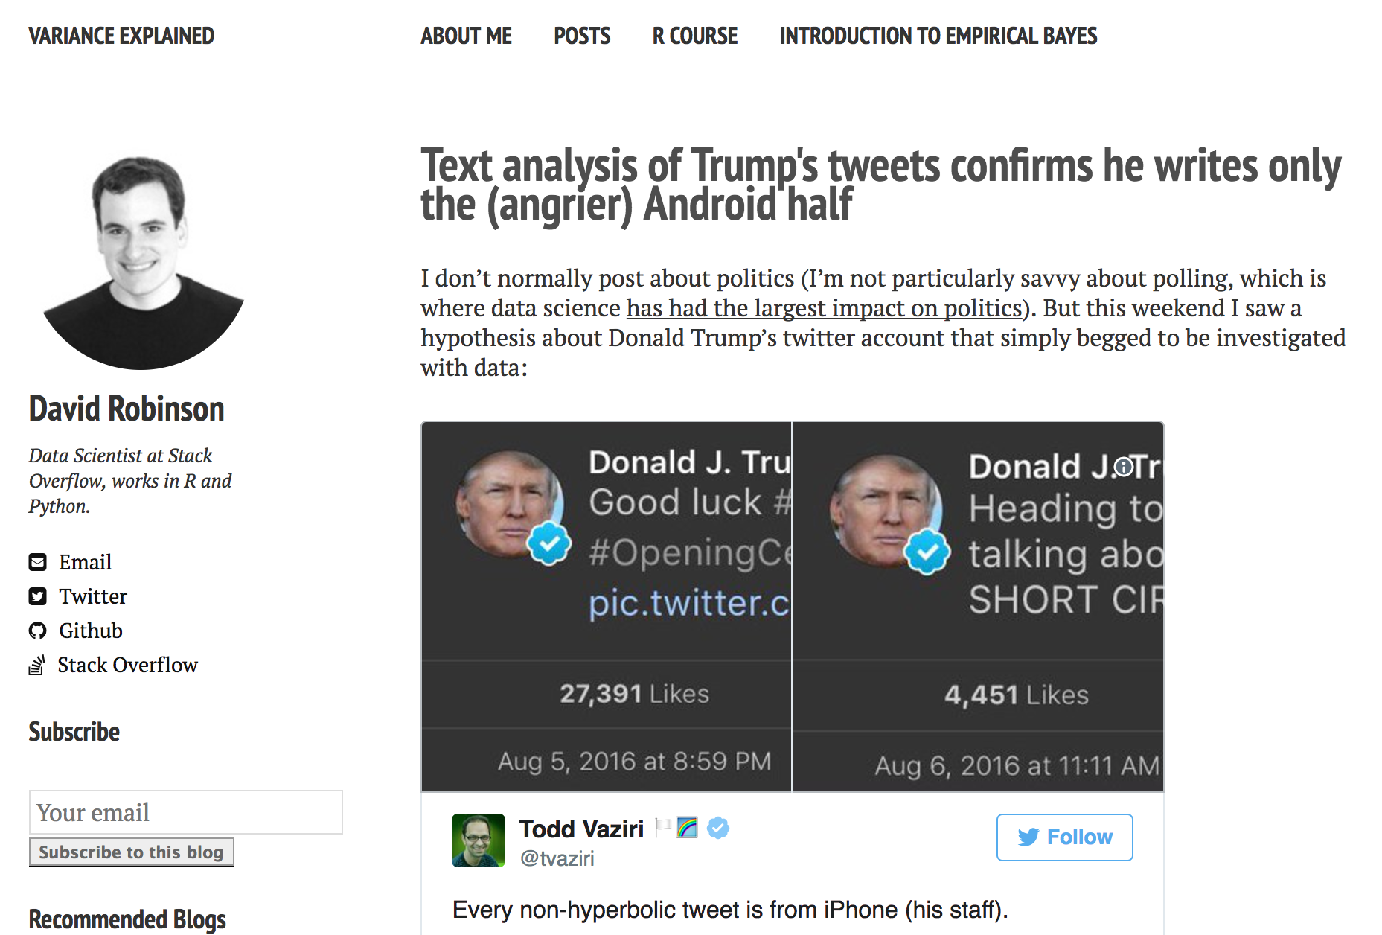
Application
Notes:
http://varianceexplained.org/r/trump-tweets/

Slide 21
Question
Is this supervised or an unsupervised problem, or rather is this a classification or a clustering issue?

